Slide 1
Data-Driven E-Commerce Analysis
By- Mohi Gupta

Slide 2
Introduction
Every online order tells a story—where it came from, how much was spent, and whether it was successfully delivered. But when thousands of transactions pile up, spotting trends and making data-driven decisions becomes challenging.
In this analysis, we leverage Power BI to break down e-commerce sales, focusing on key trends in orders, revenue, cancellations, and customer behavior. By transforming raw data into insights, we uncover patterns that can help optimize business strategies.

Slide 3

Data Preparation & Cleaning
Steps Taken
Imported raw sales data into Power BI
Identification and Removal of Irrelevant Columns
Cleaned missing & incorrect values( e.g., Fill Nan values with median in amount column, Removed some columns which is not required)
Created new calculated columns like “Day of the week" for better visualization

Slide 4
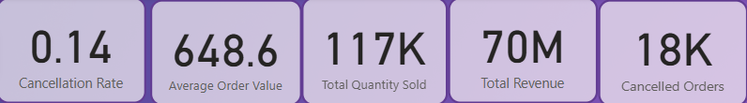
Key E-Commerce Metrics
Presents overall performance metrics
Total Sales: ₹70M , showing strong revenue generation.
Average Order Value (AOV): ₹648.6, indicating the typical amount spent per order.
Total Quantity Sold: 128.94K, representing how many individual items were sold overall.
Cancellation Rate: 0.14, to measure the percentage of total canceled orders.
Cancelled Orders: 18k, representing how many canceled orders there were overall.

Slide 5
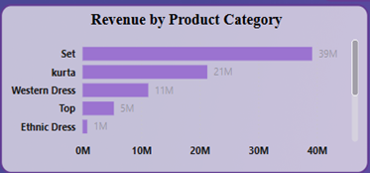
High-Demand Categories
Explanation
This bar chart highlights the best-selling product categories.
“Set” is the most popular category, contributing 55.7% of sales.
Other high-demand categories include Kurta(30%) and Western Dresses(15.7%).
This information helps in inventory planning and marketing to push top-selling categories further.

Slide 6
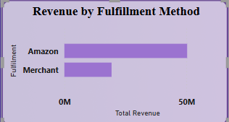
Monthly Sales Trend
Explanation
This bar chart compares total revenue generated through different fulfillment channels.
Amazon-fulfilled orders contribute the majority of the revenue (~₹50M), indicating strong logistics and faster delivery appeal to customers.
Merchant-fulfilled orders account for approximately ₹20M, showing scope for improving shipping or service standards to match Amazon fulfillment performance.
This insight supports optimizing inventory placement and enhancing merchant operations for revenue growth.

Slide 7
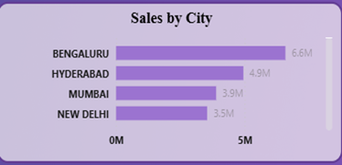
Top Performing Cities
Explanation
Bangalore: Highest revenue (₹6.6M).
Key Cities: Chennai, Gurugram, Hyderabad, Kolkata.
Action: Increase ad spend in top cities.
Opportunity: Explore mid-tier city potential.

Slide 8
Weekly Sales Pattern
Explanation
This area chart shows sales trends across the week.
Highest sales: Sunday (₹11M) – likely due to weekend shopping habits.
Lowest sales: Thursday (₹9.5M) – indicating mid-week dips.
Possible Strategies:
Run mid-week promotions to boost Thursday sales.
Enhance marketing efforts on high-traffic days like Sunday.

Slide 9
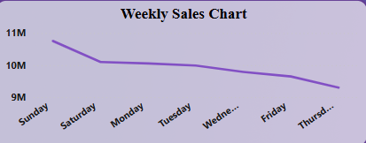
Weekly Sales Chart

Slide 10
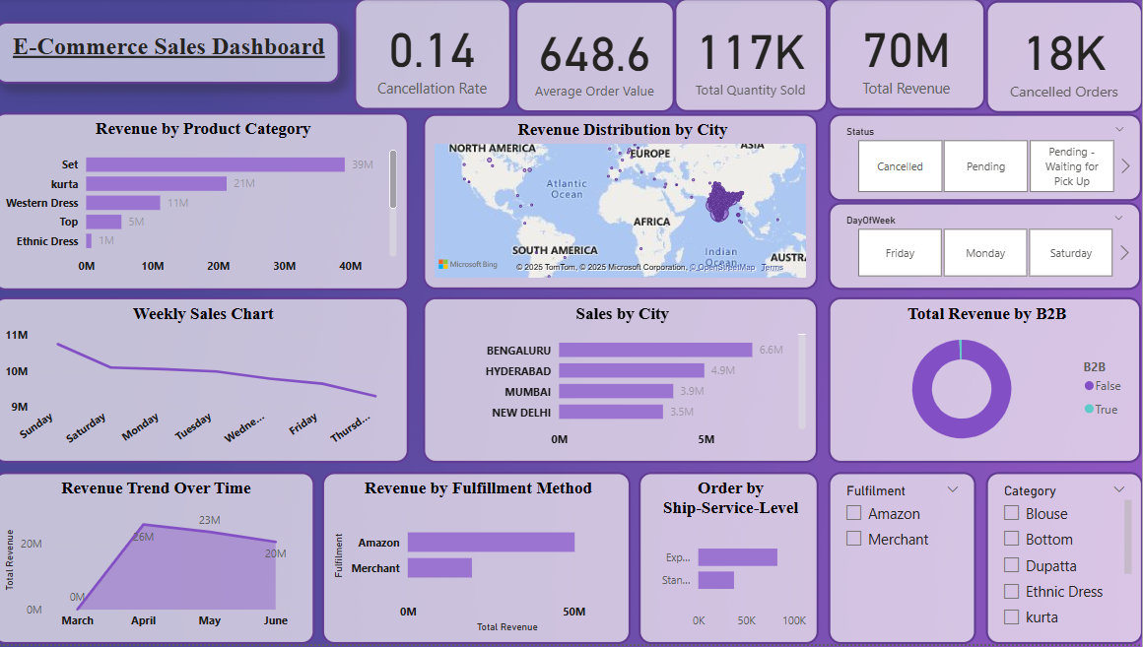
DASHBOARD

Slide 11
Conclusion
The analysis highlights key trends in e-commerce sales:
Sales peaked in April, but there was a decline in May and June, indicating the need for sustained marketing efforts.
"Set" and "Kurta" are the top-selling categories, highlighting customer preferences in apparel.
Bangalore leads in revenue, followed by Hyderabad and Mumbai, showing strong demand in these cities.
Sales peak on Sundays and drop midweek (Thursday), showing customer shopping behavior patterns.

Slide 12
Recommendations
The analysis highlights key trends in e-commerce sales:
Boost Sales in Slow Months – Offer discounts or new collections in May & June.
Reduce Returns – Improve product descriptions & quality checks.
Optimize Deliveries – Enhance supply chain efficiency & tracking.
Expand in High-Growth Cities – Focus on Bangalore, Mumbai & Hyderabad.
Leverage Weekly Trends – Run midweek promotions & Sunday flash sales.

Slide 13
Thanks!
Prepared By – Mohi Gupta Aspiring Data Analyst
For More Info- Email – mohi.workspace@gmail.com LinkedIn Id- www.linkedin.com/in/mohi-gupta-17b8b51b6

